Slide 1
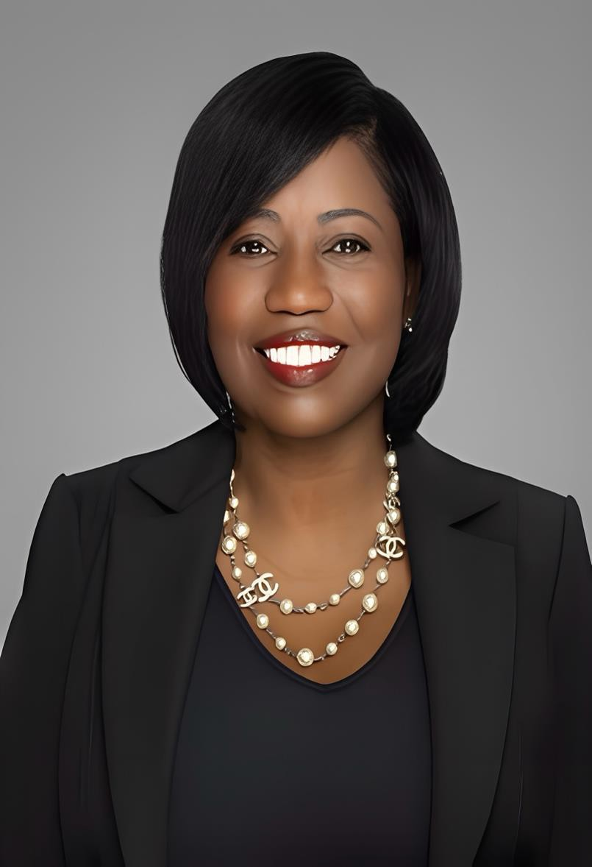
Ms. Sonya Montgomery
President & CEO
Founder, President & Chief Executive Officer
Sonya Montgomery is the Founder, President and Chief Executive Officer of The Desoto Group, a national utility infrastructure and construction services company. A licensed General Contractor, U.S. Army veteran and trailblazing entrepreneur, Montgomery has built Desoto into a formidable presence in an industry essential to America’s economic strength, energy security and future growth.
Under her leadership, The Desoto Group became the first Black-owned company in the United States to self-perform both natural gas and electric transmission and distribution construction services—an achievement that reflects Montgomery’s determination to break barriers while building a company capable of performing some of the nation’s most critical infrastructure work.
Since founding Desoto in 2010, she has led the company with a clear mandate: build critical infrastructure, develop exceptional people and create an organization capable of executing at scale. Central to that mission is her commitment to building America’s skilled construction workforce, with a primary focus on developing electric linemen and natural gas construction professionals.
Montgomery believes that investing in skilled trades can transform communities just as profoundly today as it did generations ago. Her vision is to create pathways into high-demand infrastructure careers that provide individuals and families with the opportunity to build lasting economic security while developing the workforce America needs to modernize, expand and strengthen its energy infrastructure.
Her leadership philosophy is also shaped by her service in the U.S. Army during Operation Desert Shield and Operation Desert Storm, where discipline, preparation, accountability and mission execution were paramount. Those principles remain foundational to how she leads Desoto.
For Montgomery, building infrastructure and building people are inseparable. The lessons first demonstrated by her grandfather have become part of the foundation of The Desoto Group: teach a trade, create an opportunity, strengthen a family and ultimately transform a community.
More than an entrepreneur, Montgomery is a builder—of companies, infrastructure, people and opportunity. Her vision is to build an enduring American infrastructure company while developing the skilled workforce that will power the nation for generations to come.

